Slide 1
Chapter 28
Direct Current Circuits

Slide 2
Circuit Analysis
Simple electric circuits may contain batteries, resistors, and capacitors in various combinations.
For some circuits, analysis may consist of combining resistors.
In more complex complicated circuits, Kirchhoff’s Rules may be used for analysis.
  These Rules are based on conservation of energy and conservation of electric charge for isolated systems.
Circuits may involve direct current or alternating current.
Introduction

Slide 3
Direct Current
When the current in a circuit has a constant direction, the current is called direct current.
  Most of the circuits analyzed will be assumed to be in steady state, with constant magnitude and direction.
Because the potential difference between the terminals of a battery is constant, the battery produces direct current.
The battery is known as a source of emf.
Section 28.1

Slide 4
Electromotive Force
The electromotive force (emf), ε, of a battery is the maximum possible voltage that the battery can provide between its terminals.
  The emf supplies energy, it does not apply a force.
The battery will normally be the source of energy in the circuit.
The positive terminal of the battery is at a higher potential than the negative terminal.
We consider the wires to have no resistance.
Section 28.1

Slide 5
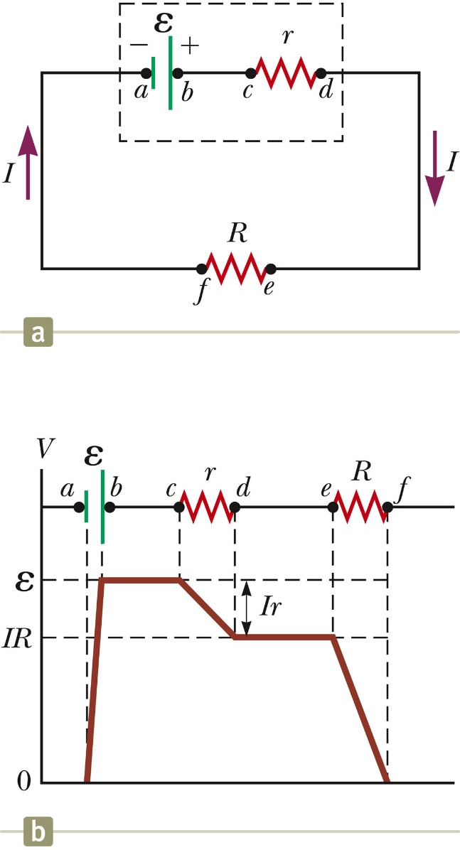
Internal Battery Resistance
If the internal resistance is zero, the terminal voltage equals the emf.
In a real battery, there is internal resistance, r.
The terminal voltage, ΔV = ε – Ir
The emf is equivalent to the open-circuit voltage.
  This is the terminal voltage when no current is in the circuit.
  This is the voltage labeled on the battery.
The actual potential difference between the terminals of the battery depends on the current in the circuit.
Section 28.1

Slide 6
Load Resistance
The terminal voltage also equals the voltage across the external resistance.
  This external resistor is called the load resistance.
  In the previous circuit, the load resistance is just the external resistor.
  In general, the load resistance could be any electrical device.
    These resistances represent loads on the battery since it supplies the energy to operate the device containing the resistance.
Section 28.1

Slide 7
Power
The total power output of the battery is
P = I ΔV = I ε
This power is delivered to the external resistor (I ² R) and to the internal resistor (I² r).
P = I² R + I² r
The battery is a supply of constant emf.
  The battery does not supply a constant current since the current in the circuit depends on the resistance connected to the battery.
  The battery does not supply a constant terminal voltage.
Section 28.1

Slide 8
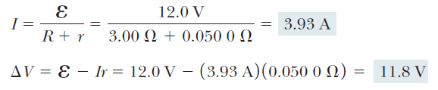
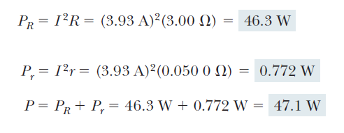
Terminal Voltage of a Battery, Example
Section 28.1

Slide 9
Resistors in Series
When two or more resistors are connected end-to-end, they are said to be in series.
For a series combination of resistors, the currents are the same in all the resistors because the amount of charge that passes through one resistor must also pass through the other resistors in the same time interval.
The potential difference will divide among the resistors such that the sum of the potential differences across the resistors is equal to the total potential difference across the combination.
Section 28.2

Slide 10
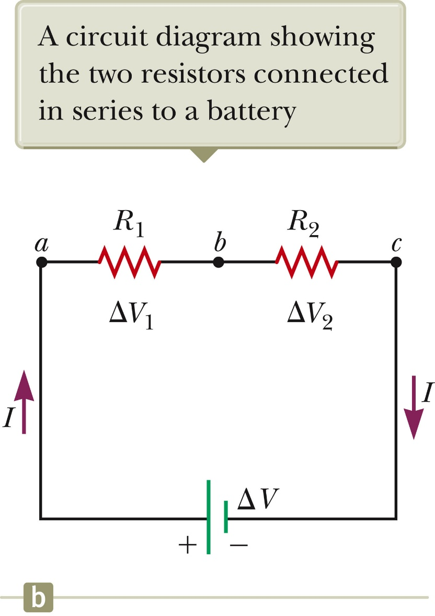
Resistors in Series, cont
Currents are the same
  I = I₁ = I₂
Potentials add
  ΔV = V₁ + V₂ = IR₁ + IR₂
  = I (R₁+R₂)
  Consequence of Conservation of Energy
The equivalent resistance has the same effect on the circuit as the original combination of resistors.
Section 28.2

Slide 11
Equivalent Resistance – Series
R_{eq} = R₁ + R₂ + R₃ + …
The equivalent resistance of a series combination of resistors is the algebraic sum of the individual resistances and is always greater than any individual resistance.
If one device in the series circuit creates an open circuit, all devices are inoperative.
Section 28.2

Slide 12
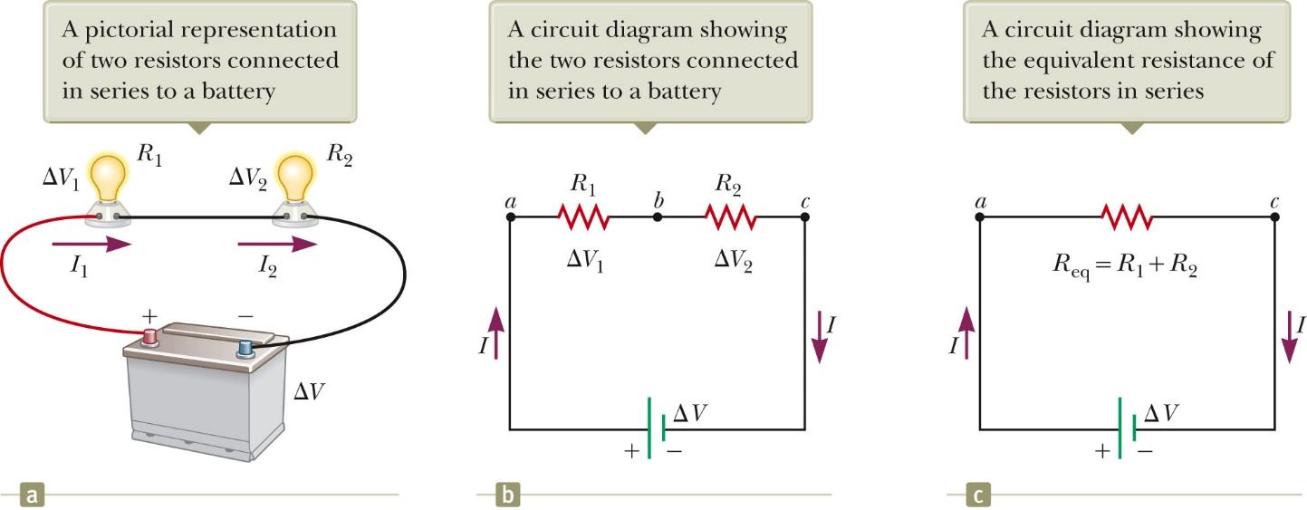
Equivalent Resistance – Series – An Example
All three representations are equivalent.
Two resistors are replaced with their equivalent resistance.
Section 28.2

Slide 13
Some Circuit Notes
A local change in one part of a circuit may result in a global change throughout the circuit.
  For example, changing one resistor will affect the currents and voltages in all the other resistors and the terminal voltage of the battery.
In a series circuit, there is one path for the current to take.
In a parallel circuit, there are multiple paths for the current to take.
Section 28.2

Slide 14
Resistors in Parallel
The potential difference across each resistor is the same because each is connected directly across the battery terminals.
ΔV = ΔV₁ = ΔV₂
A junction is a point where the current can split.
The current, I, that enters junction must be equal to the total current leaving that junction.
  I = I ₁ + I ₂ = (ΔV₁ / R₁) + (ΔV₂ / R₂)
  The currents are generally not the same.
  Consequence of conservation of electric charge
Section 28.2

Slide 15
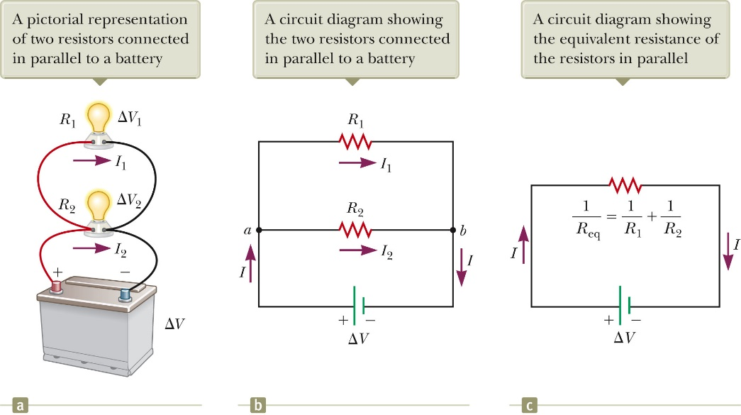
Equivalent Resistance – Parallel, Examples
All three diagrams are equivalent.
Equivalent resistance replaces the two original resistances.
Section 28.2

Slide 16
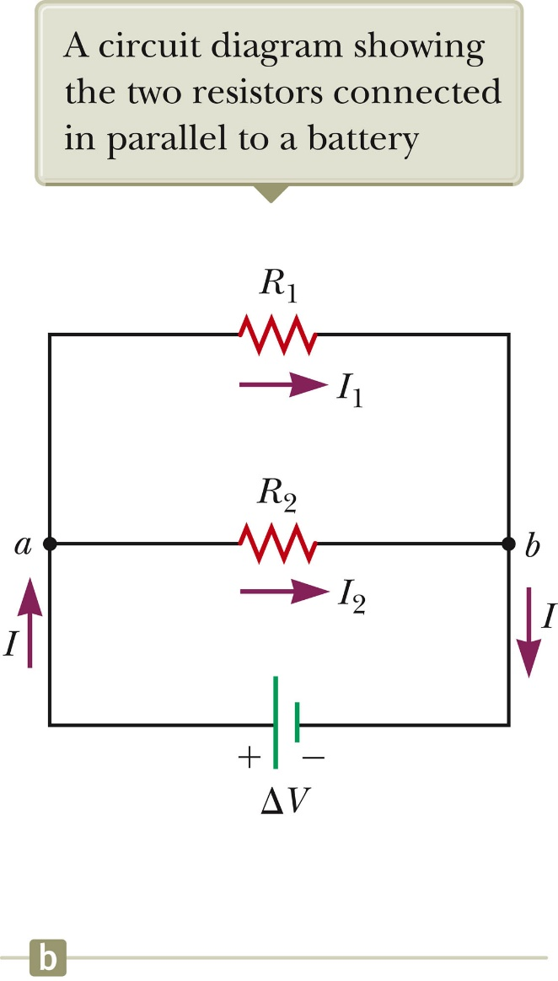
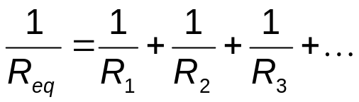
Equivalent Resistance – Parallel
Equivalent Resistance
The inverse of the equivalent resistance of two or more resistors connected in parallel is the algebraic sum of the inverses of the individual resistance.
  The equivalent is always less than the smallest resistor in the group.
Section 28.2

Slide 17
Resistors in Parallel, Final
In parallel, each device operates independently of the others so that if one is switched off, the others remain on.
In parallel, all of the devices operate on the same voltage.
The current takes all the paths.
  The lower resistance will have higher currents.
  Even very high resistances will have some currents.
Household circuits are wired so that electrical devices are connected in parallel.
Section 28.2

Slide 18
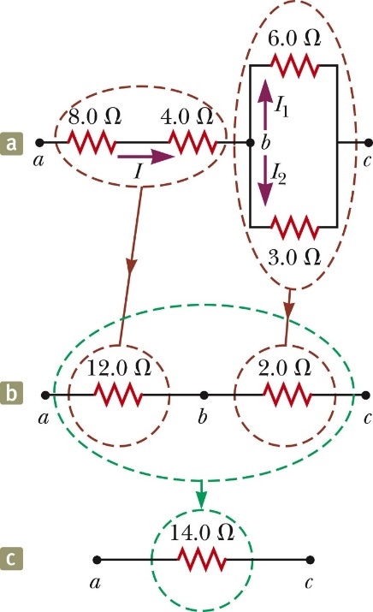
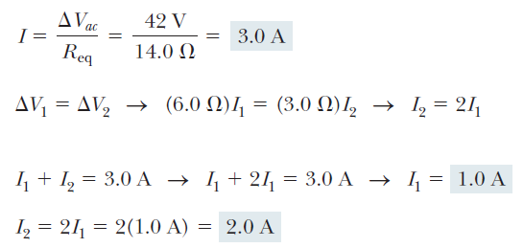
Combinations of Resistors, Example
The 8.0-Ω and 4.0-Ω resistors are in series and can be replaced with their equivalent, 12.0 Ω.
The 6.0-Ω and 3.0-Ω resistors are in parallel and can be replaced with their equivalent, 2.0 Ω.
These equivalent resistances are in series and can be replaced with their equivalent resistance, 14.0 Ω.
Section 28.2

Slide 19
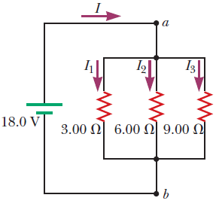
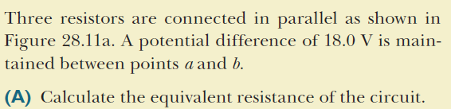
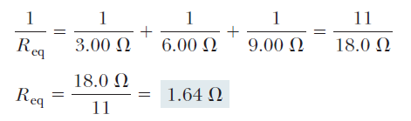

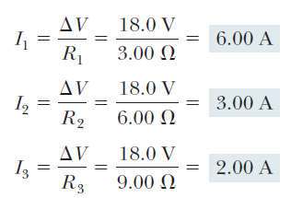
Three Resistors in Parallel, Example
Section 28.2

Slide 20
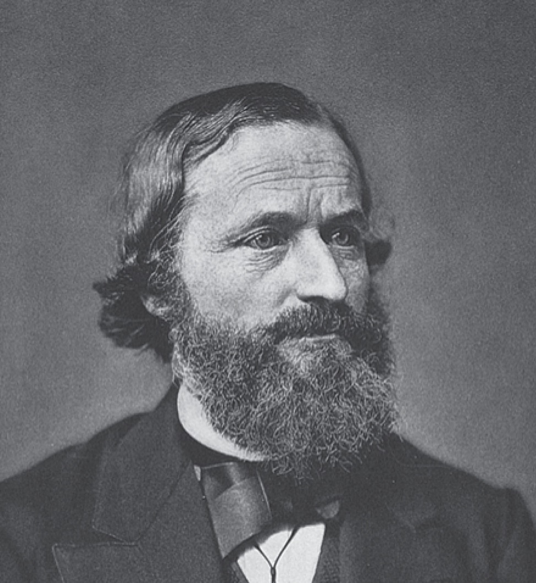
Gustav Kirchhoff
1824 – 1887
German physicist
Worked with Robert Bunsen
Kirchhoff and Bunsen
  Invented the spectroscope and founded the science of spectroscopy
  Discovered the elements cesium and rubidium
  Invented astronomical spectroscopy
Section 28.3
Notes:
Spectroscope: an apparatus for producing and recording spectra of light for examination.
spectroscope

Slide 21
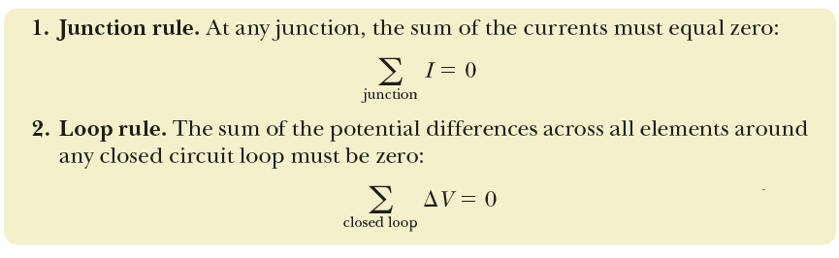
Kirchhoff’s Rules
There are ways in which resistors can be connected so that the circuits formed cannot be reduced to a single equivalent resistor.
Two rules, called Kirchhoff’s rules, can be used instead.
Section 28.3

Slide 22
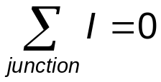
Kirchhoff’s Junction Rule
Junction Rule
  The sum of the currents at any junction must equal zero.
    Currents directed into the junction are entered into the equation as +I and those leaving as -I.
    A statement of Conservation of Charge
  Mathematically,
Section 28.3

Slide 23
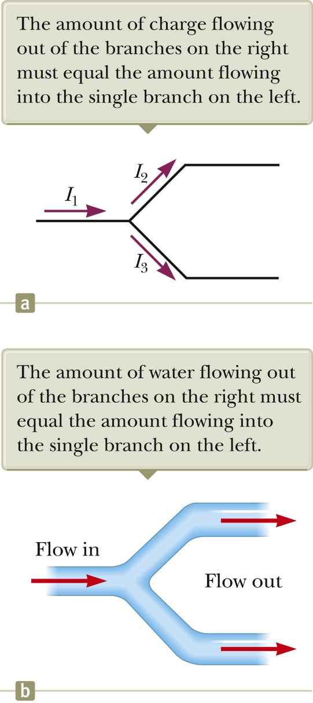
More about the Junction Rule
I₁ - I₂ - I₃ = 0
Required by Conservation of Charge
Diagram (b) shows a mechanical analog
Section 28.3

Slide 24
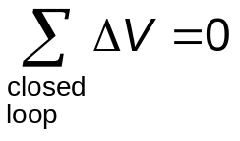
Kirchhoff’s Loop Rule
Loop Rule
  The sum of the potential differences across all elements around any closed circuit loop must be zero.
    A statement of Conservation of Energy
Mathematically,
Section 28.3

Slide 25
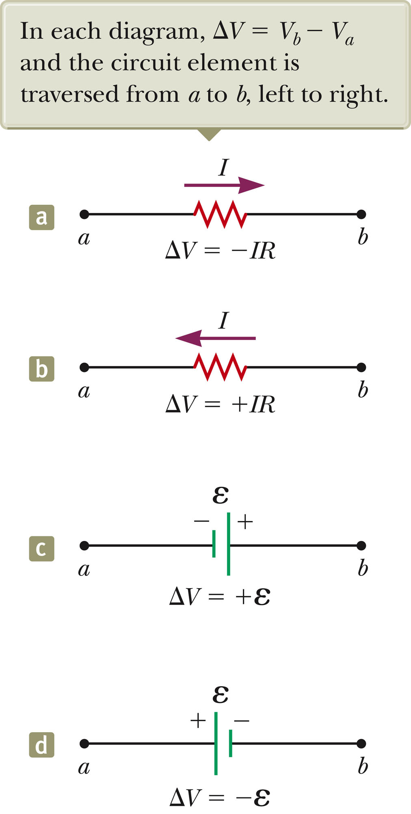
More about the Loop Rule
Traveling around the loop from a to b
In (a), the resistor is traversed in the direction of the current, the potential across the resistor is – IR.
In (b), the resistor is traversed in the direction opposite of the current, the potential across the resistor is is + IR.
Section 28.3
Notes:
The potential drops in the direction of the current

Slide 26
Loop Rule, final
In (c), the source of emf is traversed in the direction of the emf (from – to +), and the change in the potential difference is +ε.
In (d), the source of emf is traversed in the direction opposite of the emf (from + to -), and the change in the potential difference is -ε.
Section 28.3

Slide 27
Equations from Kirchhoff’s Rules
Use the junction rule as often as needed, as long as each time you write an equation, you include in it a current that has not been used in a previous junction rule equation.
  In general, the number of times the junction rule can be used is one fewer than the number of junction points in the circuit.
The loop rule can be used as often as needed so long as a new circuit element (resistor or battery) or a new current appears in each new equation.
In order to solve a particular circuit problem, the number of independent equations you need to obtain from the two rules equals the number of unknown currents.
Any capacitor acts as an open branch in a circuit.
  The current in the branch containing the capacitor is zero under steady-state conditions.
Section 28.3
Notes:
Junction rule: write as many equations as you can but each equation should have a current not included in other equations.
An independent equation is an equation in a system of simultaneous equations which cannot be derived algebraically from the other equations.

Slide 28
Problem-Solving Strategy – Kirchhoff’s Rules
Conceptualize
  Study the circuit diagram and identify all the elements.
  Identify the polarity of each battery.
  Imagine the directions of the currents in each battery.
Categorize
  Determine if the circuit can be reduced by combining series and parallel resistors.
    If so, proceed with those techniques
    If not, apply Kirchhoff’s Rules
Section 28.3

Slide 29
Problem-Solving Strategy, cont.
Analyze
  Assign labels and symbols to all known and unknown quantities.
  Assign directions to the currents.
    The direction is arbitrary, but you must adhere to the assigned directions when applying Kirchhoff’s rules.
  Apply the junction rule to any junction in the circuit that provides new relationships among the various currents.
  Apply the loop rule to as many loops as are needed to solve for the unknowns.
    To apply the loop rule, you must choose a direction in which to travel around the loop.
    You must also correctly identify the potential difference as you cross various elements.
  Solve the equations simultaneously for the unknown quantities.
Section 28.3

Slide 30
Problem-Solving Strategy, final
Finalize
  Check your numerical answers for consistency.
  If any current value is negative, it means you guessed the direction of that current incorrectly.
    The magnitude will still be correct.
Section 28.3

Slide 31
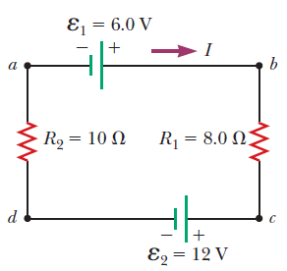
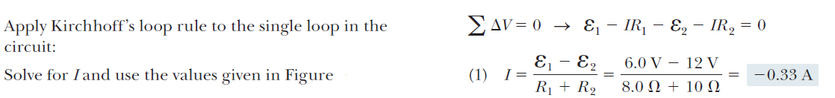
A Single-Loop Circuit, Example
Section 28.4

Slide 32
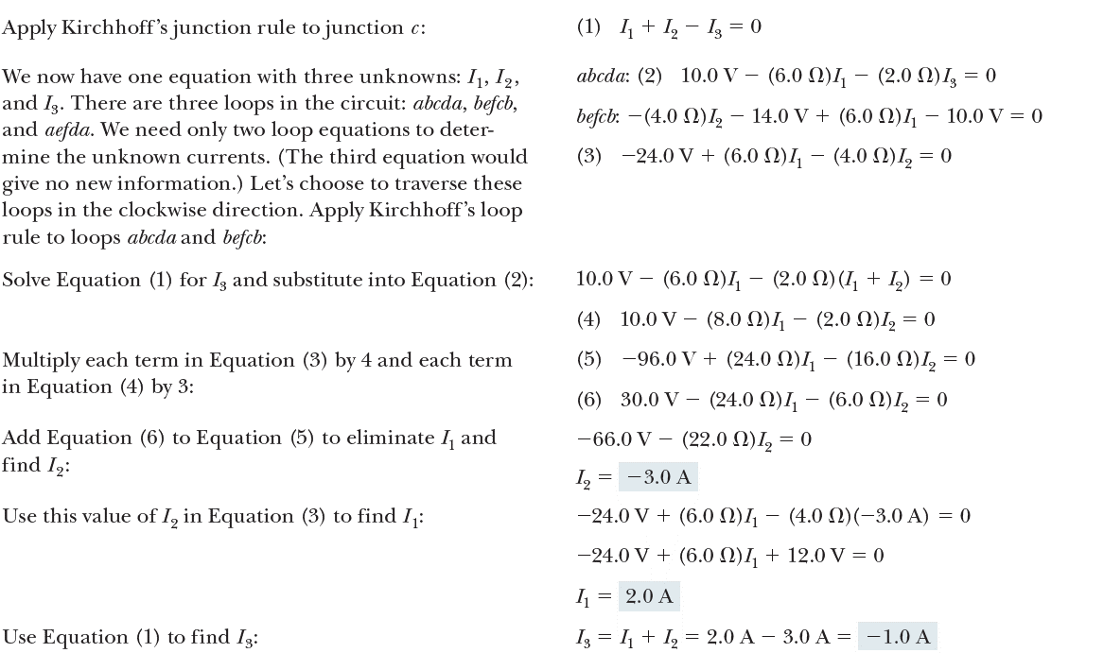
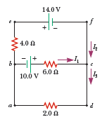
A Multi-loop Circuit, Example
Section 28.4

Slide 33
RC Circuits
In direct current circuits containing capacitors, the current may vary with time.
  The current is still in the same direction.
An RC circuit will contain a series combination of a resistor and a capacitor.
Section 28.4

Slide 34
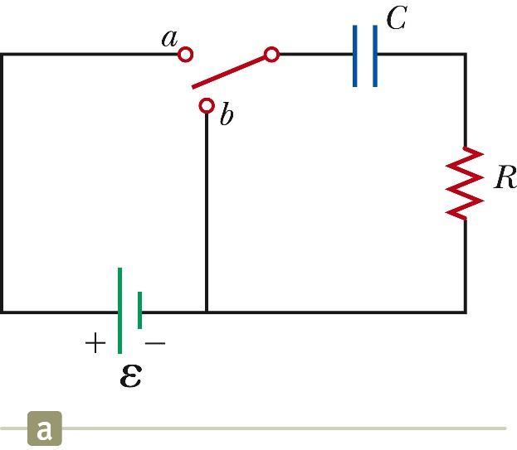
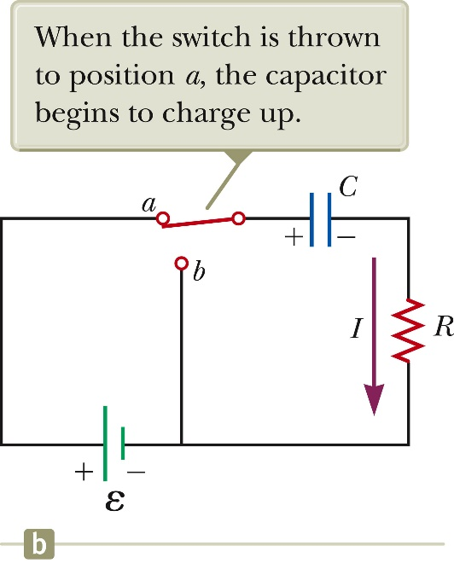
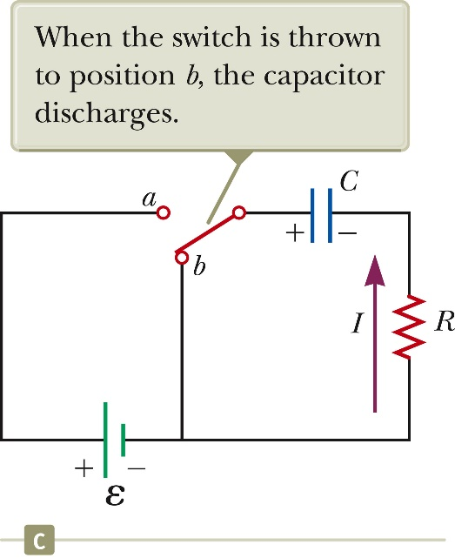


RC Circuit, Example
Section 28.4

Slide 35

Charging a Capacitor
When the circuit is completed, the capacitor starts to charge.
The capacitor continues to charge until it reaches its maximum charge
Once the capacitor is fully charged, the current in the circuit is zero.
As the plates are being charged, the potential difference across the capacitor increases.
At the instant the switch is closed, the charge on the capacitor is zero.
Once the maximum charge is reached, the current in the circuit is zero.
  The potential difference across the capacitor matches that supplied by the battery.
Section 28.4

Slide 36
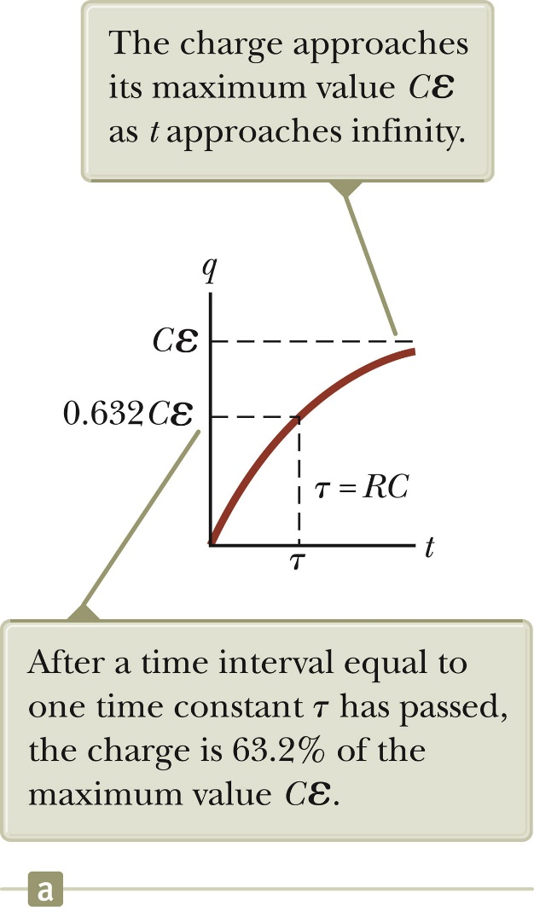



Charging a Capacitor in an RC Circuit
The charge on the capacitor varies with time.
The current can be found
  τ is the time constant
Section 28.4
Notes:
I = dq / dt

Slide 37
Time Constant, Charging
The time constant represents the time required for the charge to increase from zero to 63.2% of its maximum.
τ has units of time
The energy stored in the charged capacitor is ½ Qε = ½ Cε².
Section 28.4

Slide 38
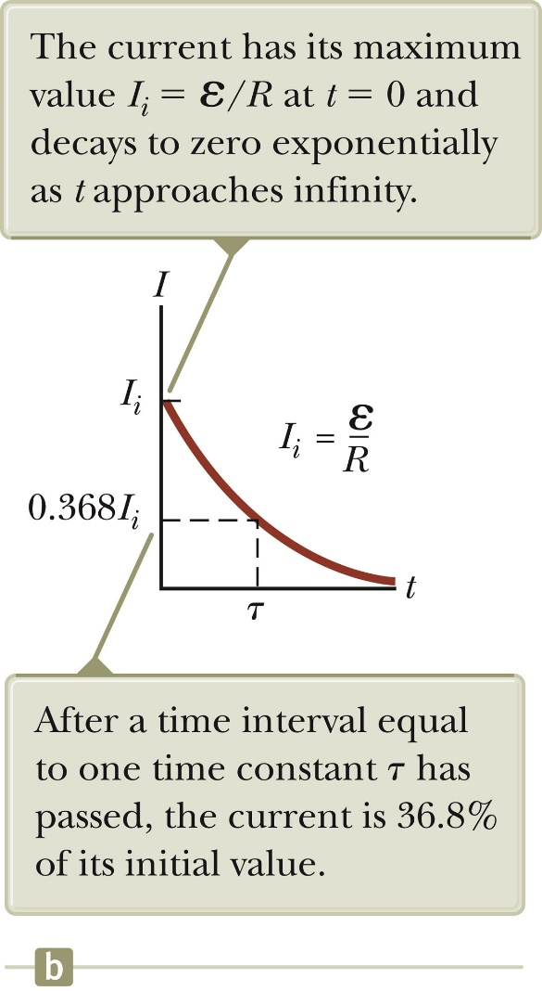


Discharging a Capacitor in an RC Circuit
When a charged capacitor is placed in the circuit, it can be discharged.
At t = τ = RC, the charge decreases to 0.368 Qmax
  In other words, in one time constant, the capacitor loses 36.8% of its initial charge.
The current can be found
Both charge and current decay exponentially at a rate characterized by t = RC.
Section 28.4

Slide 39
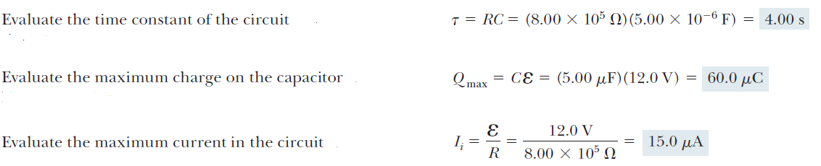

Charging a Capacitor in an RC Circuit, Example
Section 28.5

Slide 40
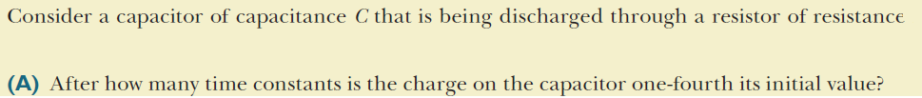
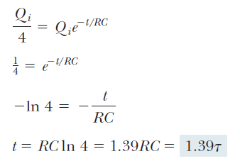
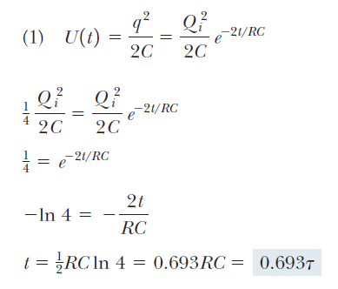
Discharging a Capacitor in an RC Circuit, Example
Section 28.5

Slide 41
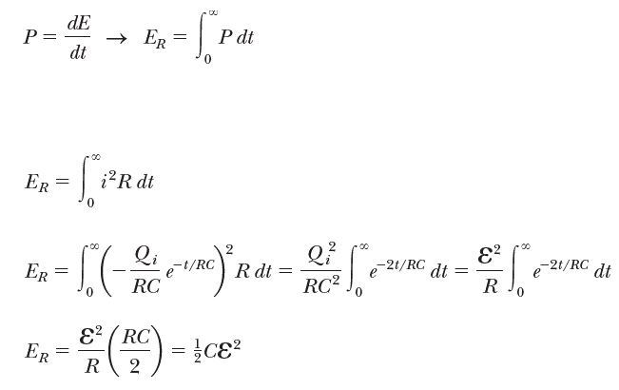
Energy Delivered to a Resistor
Section 28.5
Notes:
Evaluate the energy delivered to the resistor by
integrating the power over all time because it
takes an infinite time interval for the capacitor
to completely discharge:

Slide 42
Household Wiring
The utility company distributes electric power to individual homes by a pair of wires.
Each house is connected in parallel with these wires.
One wire is the “live wire” and the other wire is the neutral wire connected to ground.
Section 28.5

Slide 43
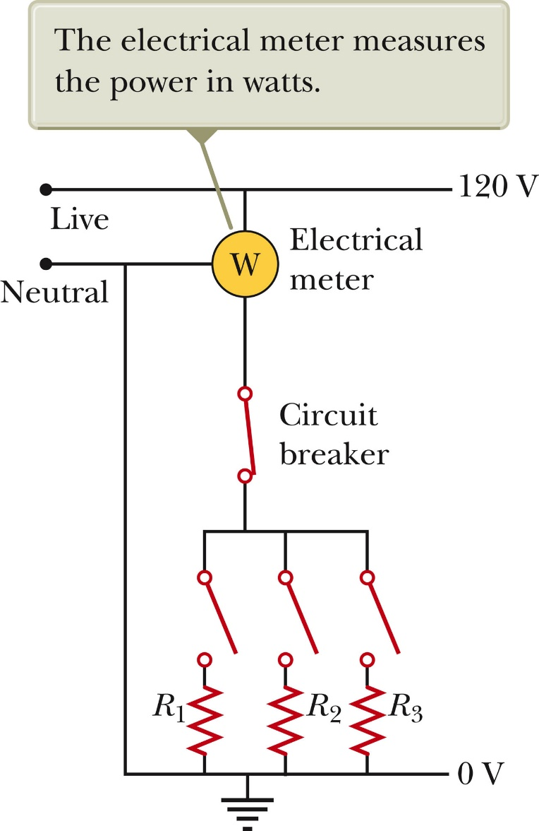
Household Wiring, cont
The potential of the neutral wire is taken to be zero.
  Actually, the current and voltage are alternating
The potential difference between the live and neutral wires is about 120 V.
Section 28.5

Slide 44
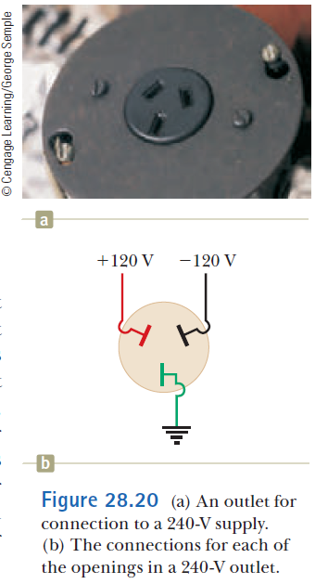
Household Wiring, final
A meter is connected in series with the live wire entering the house.
  This records the household’s consumption of electricity.
After the meter, the wire splits so that multiple parallel circuits can be distributed throughout the house.
Each circuit has its own circuit breaker.
For those applications requiring 240 V, there is a third wire maintained at 120 V below the neutral wire.
Section 28.5

Slide 45
Short Circuit
A short circuit occurs when almost zero resistance exists between two points at different potentials.
This results in a very large current
In a household circuit, a circuit breaker will open the circuit in the case of an accidental short circuit.
  This prevents any damage
A person in contact with ground can be electrocuted by touching the live wire.
Section 28.5

Slide 46
Electrical Safety
Electric shock can result in fatal burns.
Electric shock can cause the muscles of vital organs (such as the heart) to malfunction.
The degree of damage depends on:
  The magnitude of the current
  The length of time it acts
  The part of the body touched by the live wire
  The part of the body in which the current exists
Section 28.5

Slide 47
Effects of Various Currents
5 mA or less
  Can cause a sensation of shock
  Generally little or no damage
10 mA
  Muscles contract
  May be unable to let go of a live wire
100 mA
  If passing through the body for a few seconds, can be fatal
  Paralyzes the respiratory muscles and prevents breathing
Section 28.5

Slide 48
More Effects
In some cases, currents of 1 A can produce serious burns.
  Sometimes these can be fatal burns
No contact with live wires is considered safe whenever the voltage is greater than 24 V.
Section 28.5

Slide 49
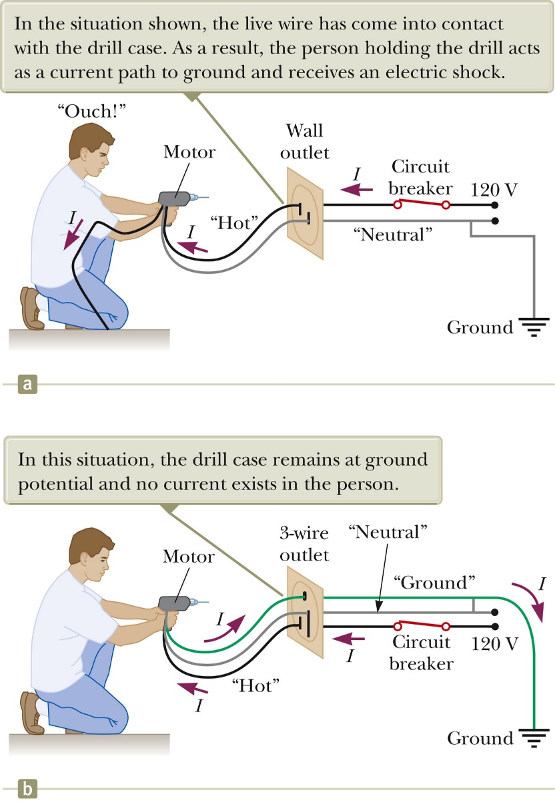
Ground Wire
Electrical equipment manufacturers use electrical cords that have a third wire, called a ground.
This safety ground normally carries no current and is both grounded and connected to the appliance.
If the live wire is accidentally shorted to the casing, most of the current takes the low-resistance path through the appliance to the ground.
If it was not properly grounded, anyone in contact with the appliance could be shocked because the body produces a low-resistance path to ground.
Section 28.5

Slide 50
Ground-Fault Interrupters (GFI)
Special power outlets
Used in hazardous areas
Designed to protect people from electrical shock
Senses currents (< 5 mA) leaking to ground
Quickly shuts off the current when above this level
Section 28.5

